Slide 1

RECOMMENDATION SYSTEM
BDM 1113 2022F T1 Final Project

Slide 2

TEAM –GROUP 3
Karthi Kuthalingam
Sarathchandran Santhosh
Amrita Gyawali
Navneet kaur

Slide 3

It is an information filtering system from a bulk amount of options that we have in the market based on the users needs.
We have a lot of competitors for each product in the market.
Choosing the best one is the users responsibility.

Slide 4

To help the user to purchase a good product from the websites by suggesting a set of product based on the personalized options of the user.
It will suggest a small subset of best options from a huge amount of available products.

Slide 5

OUR SYSTEM
A Recommendation System for Televisions.
We have a lot of Companies offering Televisions with different new technologies.
User have to provide their constraints and the qualities needed.
From our database, we will pick the product with those features and show it to the user.
Hence, the user can go through the list and choose the product.

Slide 6
Python
Python libraries : Beautiful soup, Panda
Pymongo
Database: MongoDB
TECHNOLOGIES USED

Slide 7
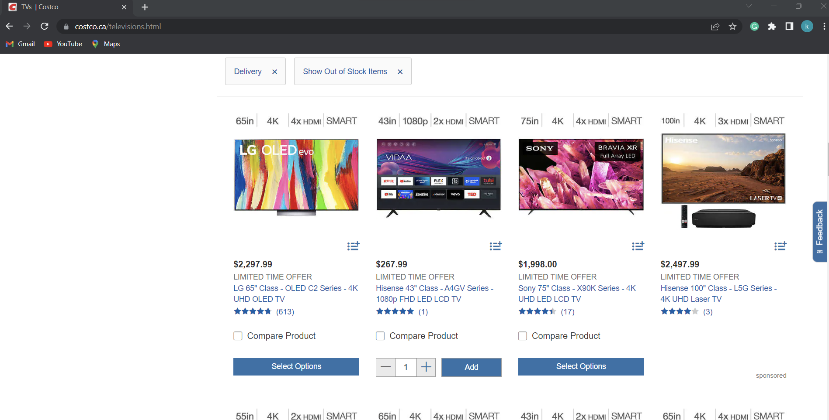
Implementation
Stage 1: WebScrapping
Selected an online website which sells television.
https://www.costco.ca/

Slide 8
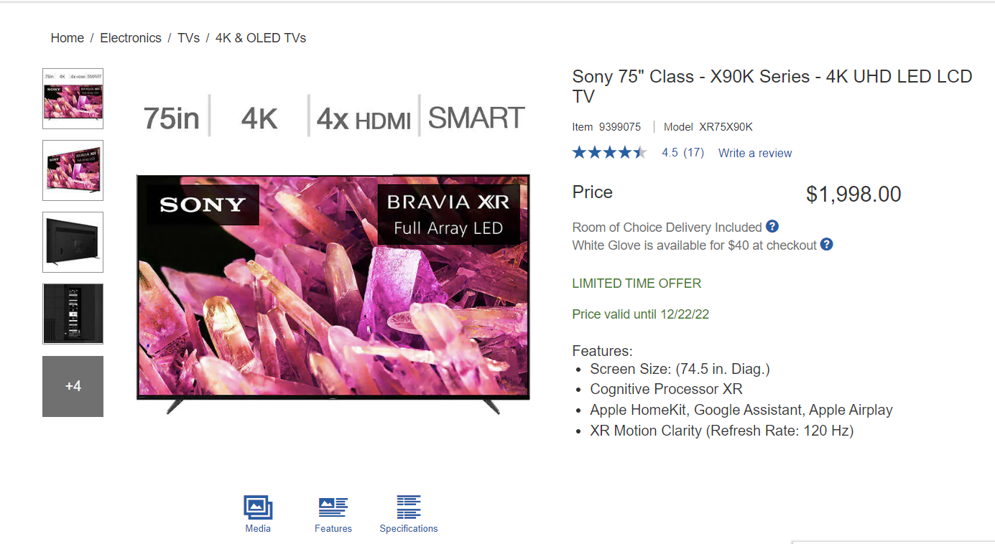
Scrapped the below details which will be a main consideration for a user before buying a product using Beautiful Soup:
Product Name
Price
Rating
Review Count
Features

Slide 9
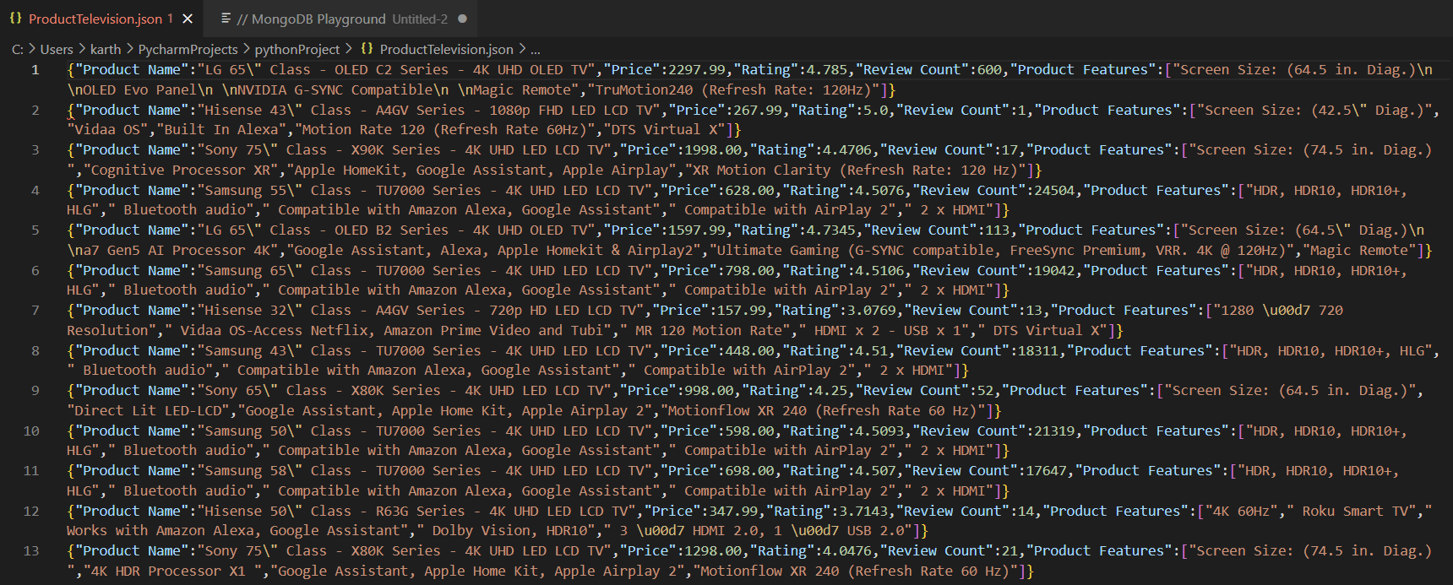
Created a dataframe using the collected data and converted it into a JSON file using panda.

Slide 10
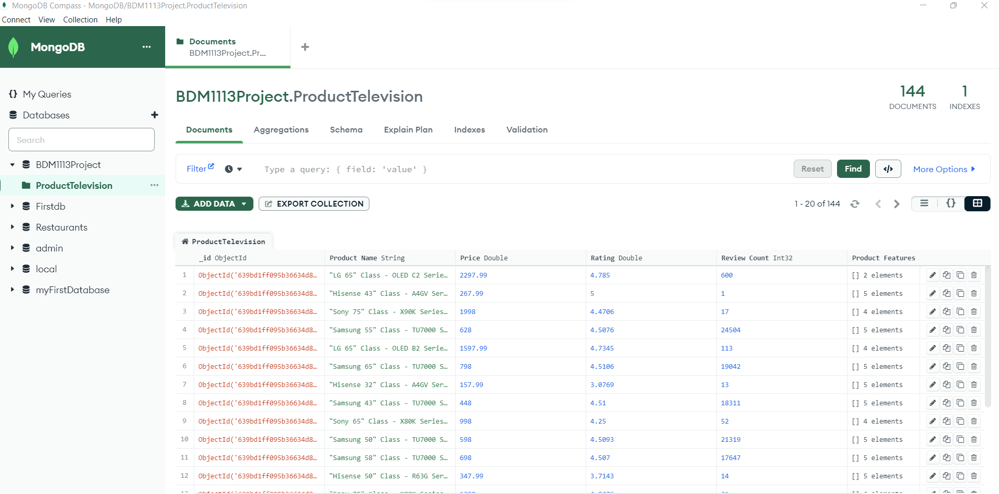
JSON file is loaded to MongoDB with the help of Pymongo.

Slide 11
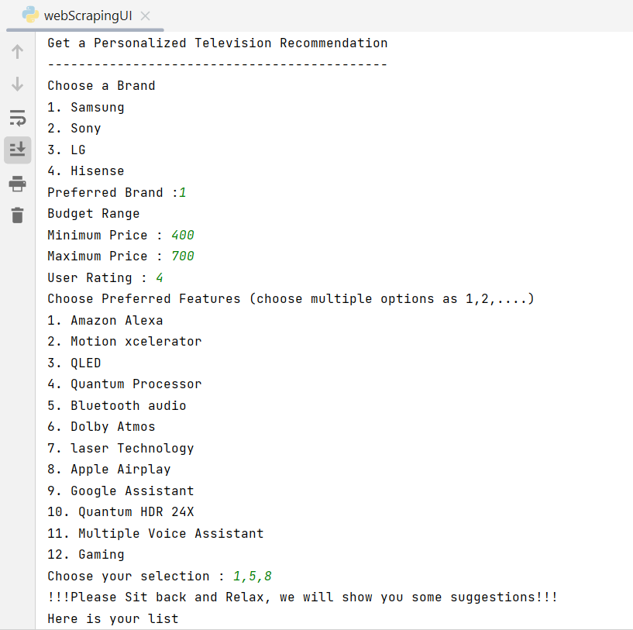
Stage 2:
A console is created for the user to enter their preferences with python.
If user did not choose budget and rating, by default it will show the product of price range $0-$10000 and rating greater than 4.

Slide 12
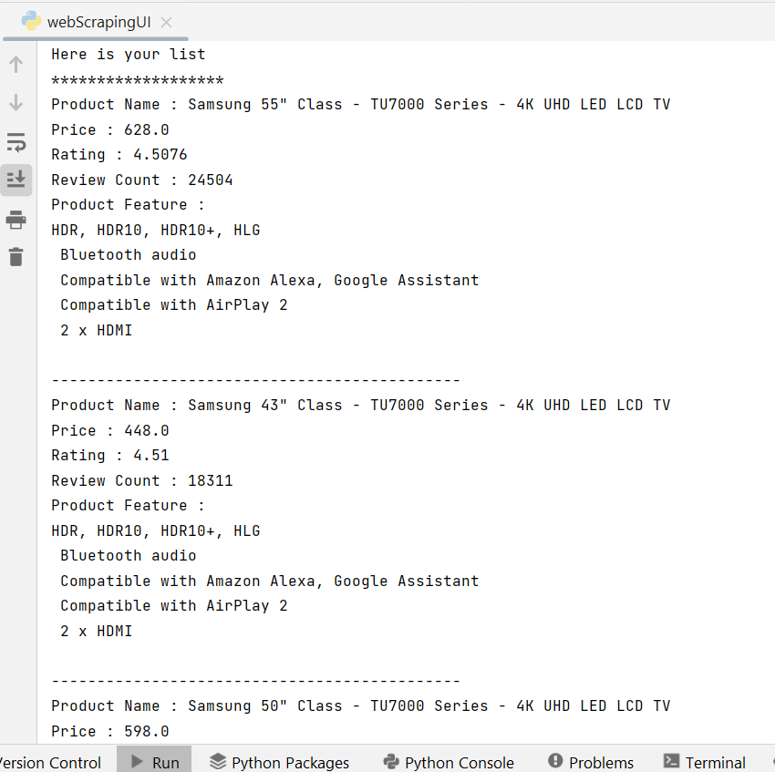
Get all the inputs from the user and queried our database: MongoDB.
Display the recommended product for the user.

Slide 13
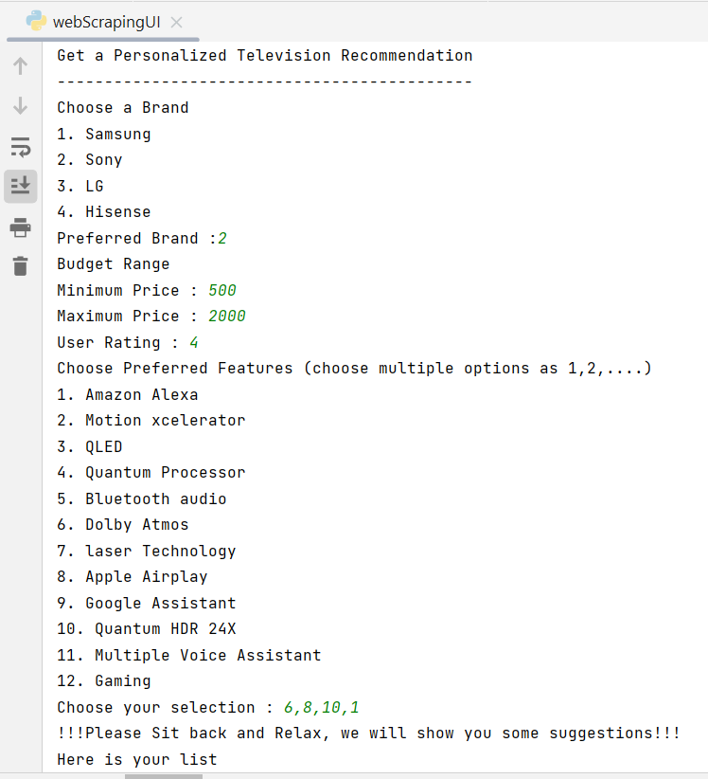
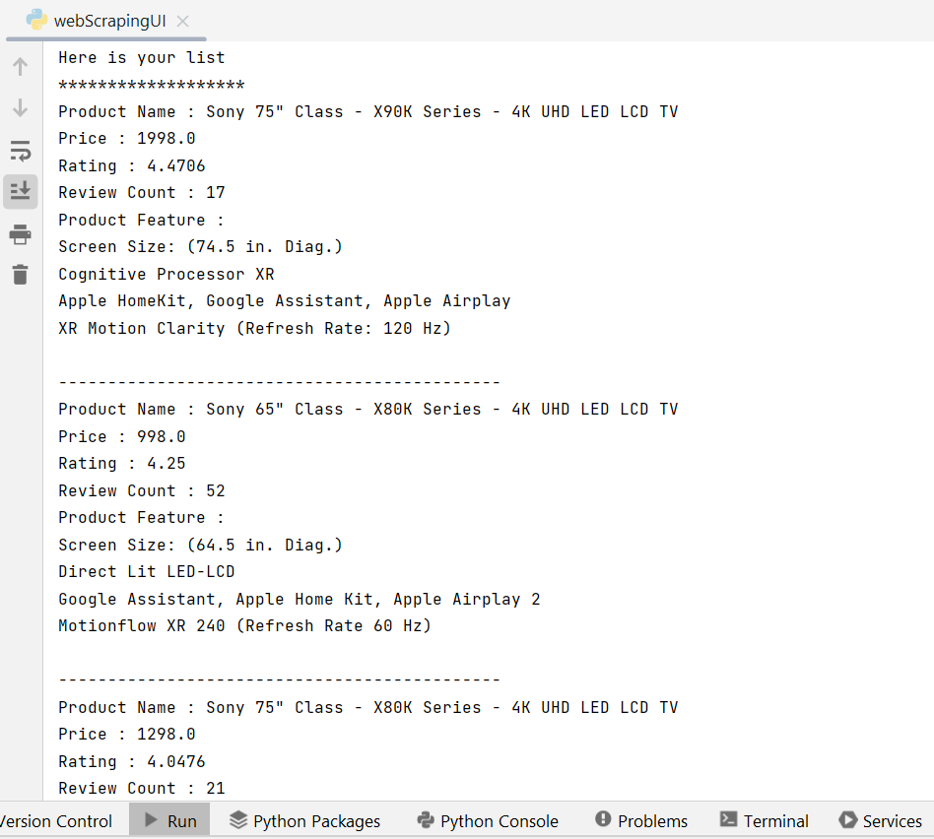
RESULT : 1

Slide 14
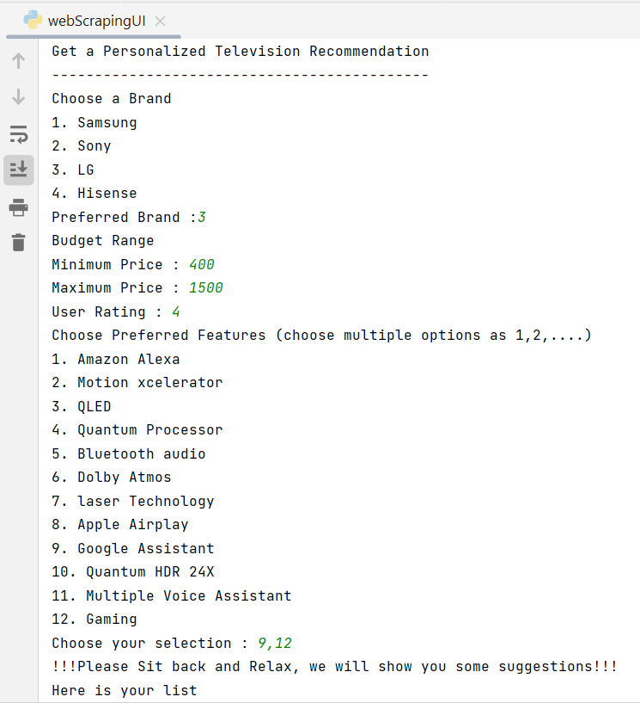
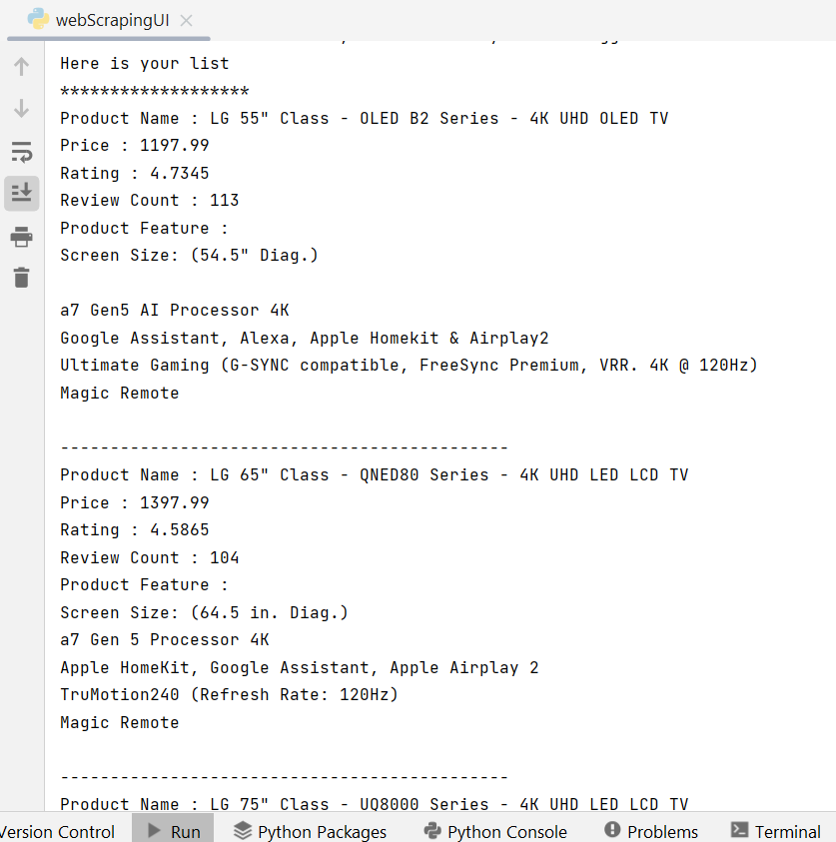
RESULTS: 2

Slide 15

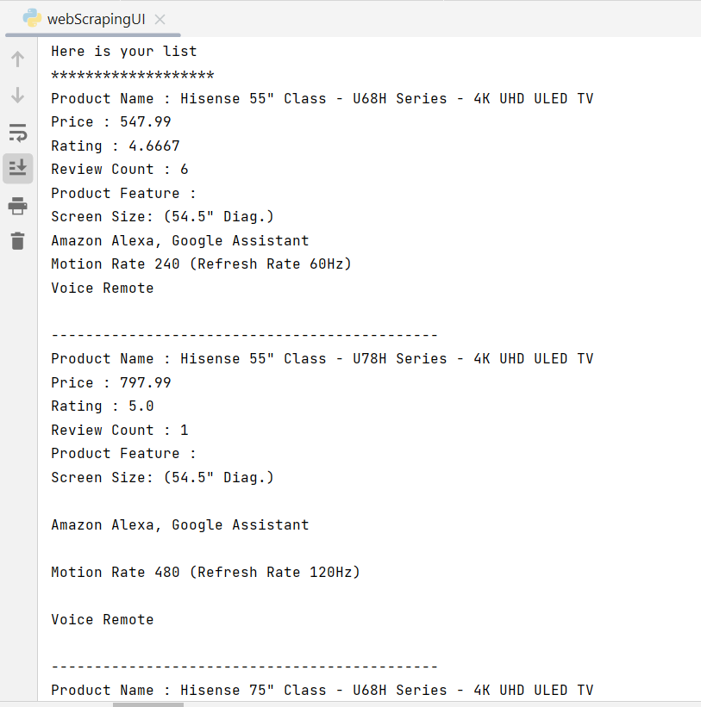
RESULTS: 3

Slide 16
CONCLUSION
Based on the recommendation , user can choose the particular product instead of going through the entire website.
We can include a lot of products available in the market in this system. And it will be similar to filter out the products from a website.

Slide 17

THANK YOU

